Slide 1
Gradual Evolution In The Field Of NLP
Early Models to Transformer Model

Slide 2
Early NLP Models
Bag of Words
N-Grams
Term Frequency-Inverse Document Frequency (TF-IDF)

Slide 3
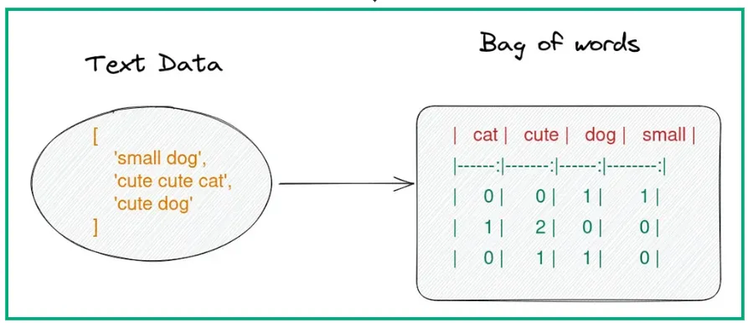
Bag-of-Words (BoW)
One of the earliest methods for representing text in machine learning models.
How It Works: Each document is represented as a vector of word frequencies, without considering the order of the words.
Limitations: Ignores the order of words, lacks contextual understanding, and can result in very high-dimensional vectors.
YouTube Link

Slide 4
Bag-of-Words (BoW)
Bag of Words(BoW) is a special case of N-Grams where n=1 i.e. one word

Slide 5
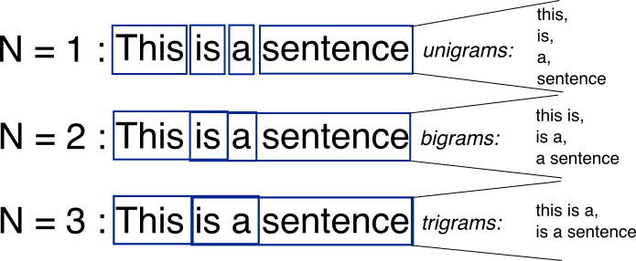
N-Grams
An improvement over the BoW model, representing sequences of n words together.
How It Works: Captures local word dependencies by considering fixed-length sequences (bigrams, trigrams, etc.).
Limitations: Limited to a fixed window size, high-dimensional representations, sparsity, and lack of understanding for long-range dependencies.
YouTube Link

Slide 6
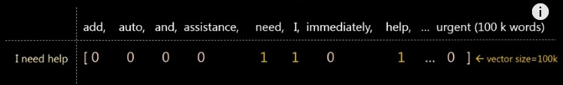
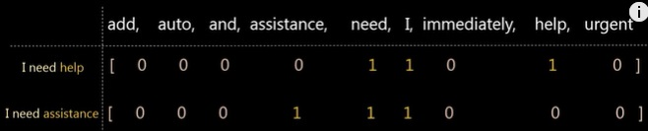
Limitations of BoW and N-Grams
Large vector size even for a small sentence:
Highly distinct vectors for similar sentences:

Slide 7
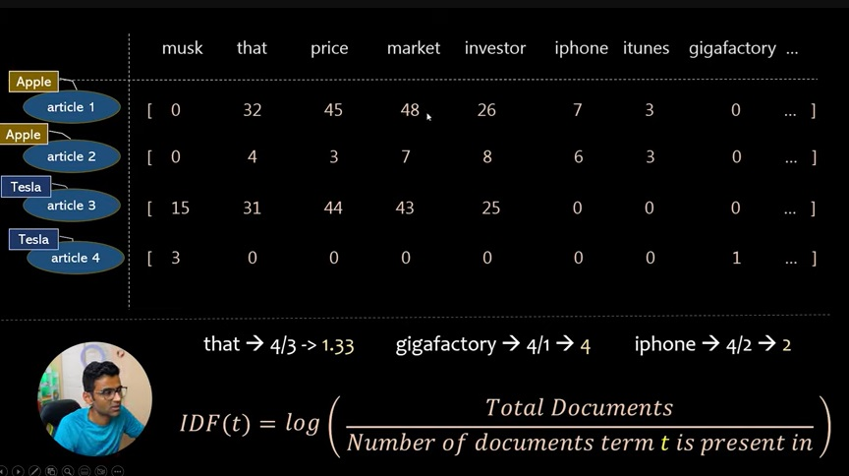
TF-IDF
Term Frequency-Inverse Document Frequency (TF-IDF)

Slide 8
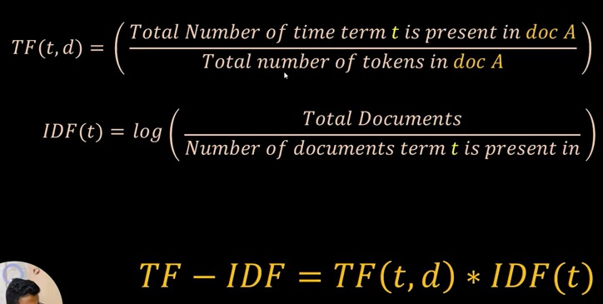
TF-IDF
Term Frequency-Inverse Document Frequency (TF-IDF)

Slide 9
Word Embedding (2013-2016)
Word2Vec
GloVe
FastText

Slide 10
Word2Vec
Introduced by Google in 2013, it used neural networks to learn continuous vector representations of words..
Key Idea: Words with similar meanings should have similar embeddings.
Variants:
Continuous Bag of Words (CBOW)
Skip-gram
YouTube Link

Slide 11
Word2Vec
Continuous Bag of Words (CBOW)
Predicts the target word (the centre word) from the context words (the surrounding words).
Skip-gram
Predicts the context words from the target word (the centre word).

Slide 12
Word2Vec
Example of Skip-gram
Let's say we have a sentence: "The cat sits on the mat."
Target word: "sits"
Context words: ["the", "cat", "on", "the", "mat"]
Word2Vec will learn to predict the context words given the target word "sits"

Slide 13
Word2Vec
Limitations
Limited to Local Context:
Word2Vec considers only a fixed-size window around the target word, limiting its understanding of broader context.
Does Not Capture Sub word Information:
Word2Vec treats each word as a unique token, which means it does not consider morphological aspects (like prefixes or suffixes) that might provide additional meaning.
Vocabulary is Fixed:
Once trained, Word2Vec cannot handle out-of-vocabulary (OOV) words, i.e., words it hasn't seen before.

Slide 14
GloVe
Global Vectors for Word Representation (GloVe) was introduced by Stanford researchers in 2014. Unlike earlier models like Word2Vec that use local context windows, GloVe leverages both global and local statistical information from a corpus to learn word embeddings. The goal is to produce word vectors that capture semantic meanings and relationships between words.
How It Works:
GloVe begins by constructing a word co-occurrence matrix from a large corpus. This matrix captures how frequently each word co-occurs with every other word within a specified context window. For example, if "ice" and "solid" frequently appear together, their co-occurrence value will be high.

Slide 15
GloVe
Limitations of GloVe:
Static Word Embeddings:
Similar to Word2Vec, GloVe generates a single vector per word, regardless of its context, leading to problems with words that have multiple meanings (e.g., "bank" as a financial institution vs. the side of a river).
Computationally Expensive:
Creating and factorizing the co-occurrence matrix is computationally expensive and requires significant memory.

Slide 16
FastText
FastText, developed by Facebook AI Research, builds on Word2Vec and addresses some of its limitations by incorporating sub word information.
How It Works:
Sub word Information:
FastText breaks down words into character n-grams (subwords). For example, the word "playing" might be broken into "play", "lay", "ayin", etc.
Embeddings for Subwords:
It generates embeddings for these subwords and then combines them to form the word's final embedding.

Slide 17
FastText
Example of FastText
For the word "playing", FastText considers its parts like:
"play", "playing", "lay", "ing", etc.
This approach allows FastText to create embeddings for words it hasn't seen before (out-of-vocabulary words) by using the subword information
Limitations of FastText
Still Context-Independent:
Even with subword information, FastText generates a single embedding per word without considering its specific context within a sentence.

Slide 18
Sequence Models (1997-2014)
Recurrent Neural Networks (RNNs)
LSTMs
GRU

Slide 19
The Need for Sequence Models
Limitations of Word Embeddings
Static Representations: Word embeddings assign a single vector to each word, regardless of the context in which it appears. For example, the word "bank" will have the same vector whether it refers to a financial institution or the side of a river.
Lack of Sequence Information: Word embeddings do not capture the order of words in a sentence. A sentence like "cat bites dog" would have the same embedding representation as "dog bites cat," which is problematic because the two sentences have very different meanings.
No Handling of Long-Range Dependencies: Word embeddings only represent individual words; they do not account for relationships or dependencies between words that are far apart in a sentence or document.

Slide 20
The Need for Sequence Models
Advantages of Sequence Models
Dynamic Contextual Representations:
Unlike word embeddings, which assign a fixed vector to each word, sequence models produce dynamic word representations. This means that the vector representation of a word changes depending on the surrounding words in the sentence.
For instance, in the sentences "I went to the bank to deposit money" and "The river bank was covered in snow," sequence models will learn different representations for the word "bank" based on the different contexts provided by the other words.

Slide 21
The Need for Sequence Models
Advantages of Sequence Models
Capturing Word Order:
RNNs and LSTMs are designed to handle sequences of data, meaning they take into account the order in which words appear. They can understand that "cat bites dog" and "dog bites cat" have different meanings due to the sequence of the words.
By processing words sequentially, these models maintain information about which words came before and use that information to better understand the meaning of the current word.

Slide 22
The Need for Sequence Models
Advantages of Sequence Models
Learning Long-Range Dependencies:
LSTM and GRU (Gated Recurrent Unit) networks were developed to address the limitations of standard RNNs, which struggled with capturing long-range dependencies due to the vanishing gradient problem. LSTMs use gating mechanisms to selectively retain or forget information, allowing them to learn dependencies over long distances within the text.
For example, in the sentence "The cat that chased the dog ran up the tree," the relationship between "cat" and "ran" might be separated by several intervening words. Sequence models are capable of learning such long-range dependencies.

Slide 23
Recurrent Neural Networks (RNNs)
Recurrent Neural Networks (RNNs) create a connection between all the words in a sequence by processing them from start to finish and remembering their relationships.
Limitations:
However, this can lead to a problem where the RNN memorizes every word, regardless of whether it's important or not.
Each word must be processed one after the other, which prevents parallelization and slows down training and inference.

Slide 24
Long Short-Term Memory (LSTM) Networks
Long Short-Term Memory (LSTM) networks are a type of Recurrent Neural Network (RNN) designed to improve on the limitations of standard RNNs.
Unlike regular RNNs, LSTMs can selectively remember or forget information, allowing them to focus on important words and relationships in a sequence while ignoring less important details.
This helps LSTMs better understand and process longer sequences of text.
Limitations: Computationally expensive and difficult to parallelize due to their sequential nature.

Slide 25
Gated Recurrent Unit (GRU) (2014)
A simpler variant of LSTM, designed to achieve similar performance with less computational overhead.
Limitations:
Still suffers from the same parallelization issues as LSTMs.

Slide 26
Attention Mechanism (2014-2017)
Attention Mechanism (2014)
Self-Attention (2017)

Slide 27
Limitations of RNN & LSTMs
While RNNs and LSTMs improved upon word embeddings by capturing sequential information, they still had some limitations:
Sequential Processing: RNNs and LSTMs process words one at a time, which can be slow, especially for long sequences. They are not easily parallelizable, leading to inefficiencies in training and inference.
Difficulty in Capturing Very Long-Range Dependencies: Despite the improvements with LSTMs and GRUs, these models can still struggle with dependencies that span very long sequences.

Slide 28
Attention Mechanism
The attention mechanism is like giving different parts of the input different levels of importance, depending on the task. Imagine you are translating a sentence from English to French. Instead of looking at the whole sentence equally, you might focus more on certain words when translating a specific word in the target language.
Example: If you want to translate "The cat sat on the mat" into French, the attention mechanism helps you know which English word (like "cat") to focus on when you are translating into French ("le chat").
It focuses on the important words in one sentence when generating another sentence.

Slide 29
Self-Attention
Self-attention is a specific type of attention used to understand the relationships between different words in the same sentence. It helps every word in a sentence to pay attention to every other word to understand the context better.
Example: For the sentence "The cat sat on the mat," self-attention helps the model understand how each word is related to every other word. When focusing on the word "cat," it will also pay attention to the word "sat" to understand that "cat" is the one who "sat. “
It helps to understand all the relationships within one sentence.

Slide 30
Key Difference in Simple Terms
Attention Mechanism:
Compares two different sequences (like a source sentence and a translated sentence).
Self-Attention:
Compares all parts within the same sequence (like all the words in one sentence).

Slide 31
Visual Analogy
Attention Mechanism:
Imagine you're looking at a painting of a landscape and trying to paint a similar one. You focus on different parts (like the sky or the trees) one at a time.
Self-Attention:
Imagine you're describing the same painting to someone else. You look at every part of the painting and describe how each part relates to the others (e.g., the tree is next to the house, the sun is above the mountains).

Slide 32
The Transformer model, introduced in "Attention is All You Need" (2017), relies entirely on the self-attention mechanism, enabling it to process words in parallel rather than sequentially.

Slide 33
The Transformer (2017)
BERT
GPT
T5 (Text-To-Text Transfer Transformer) (2019)
Transformer-XL, XLNet, and Other Variants (2019-2020)

Slide 34
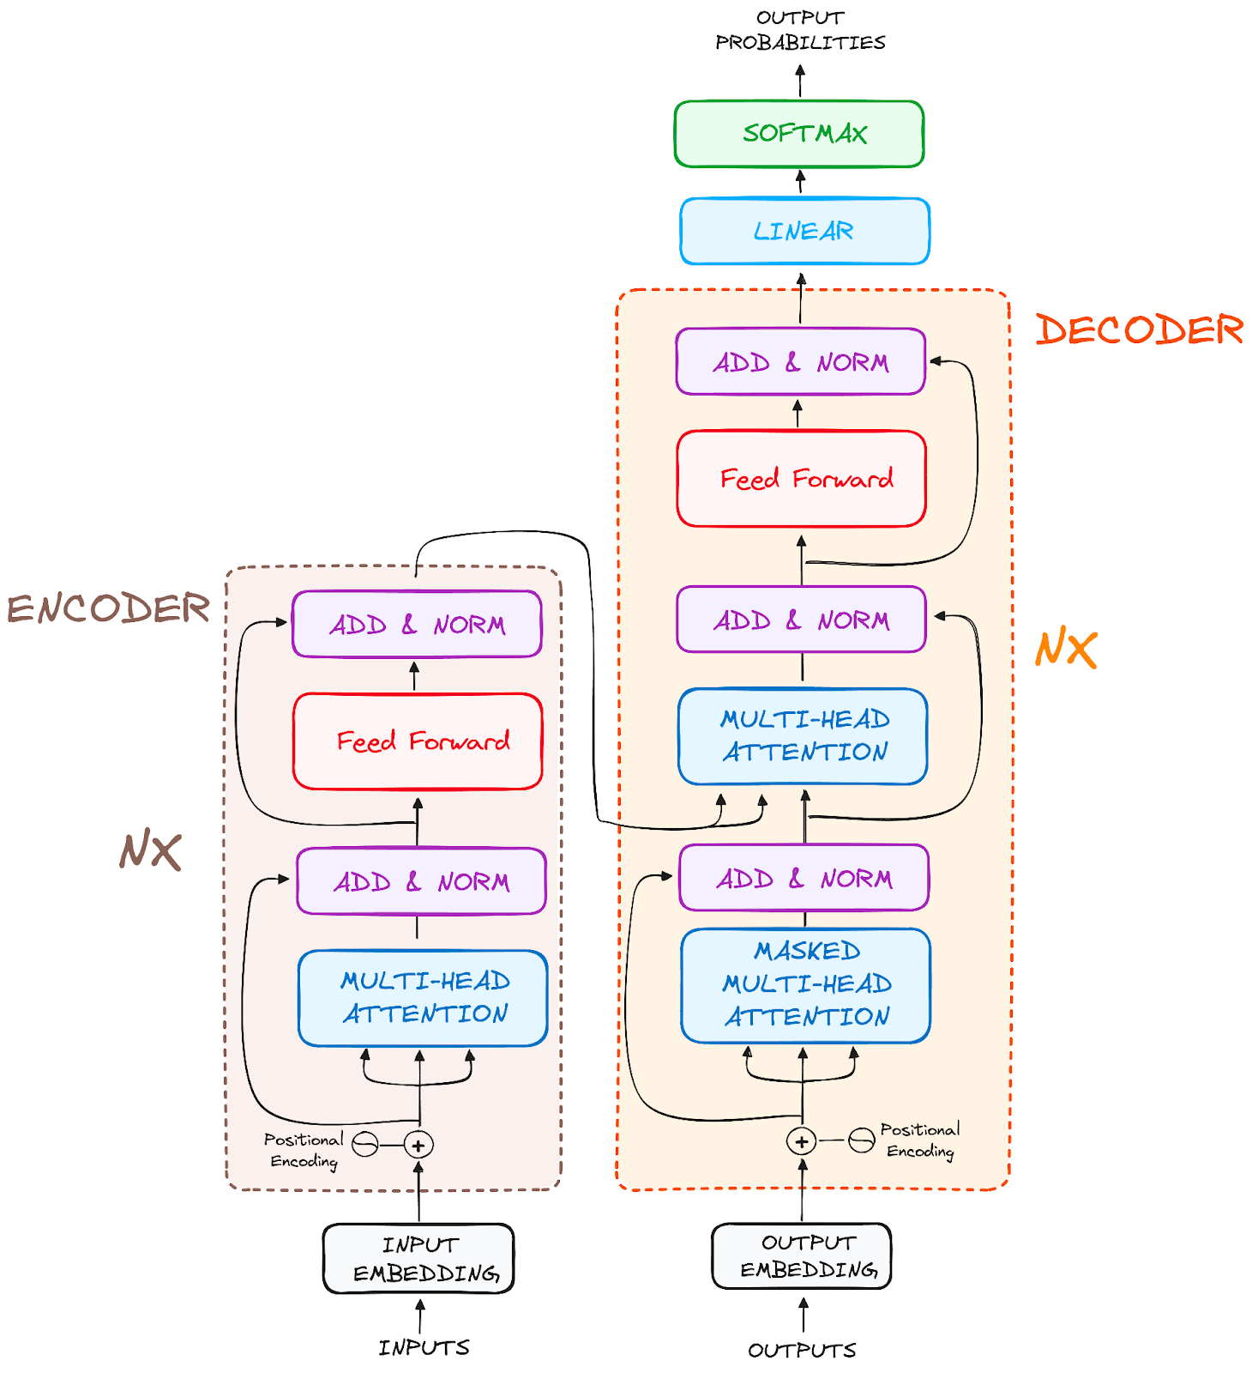
Transformer Model

Slide 35
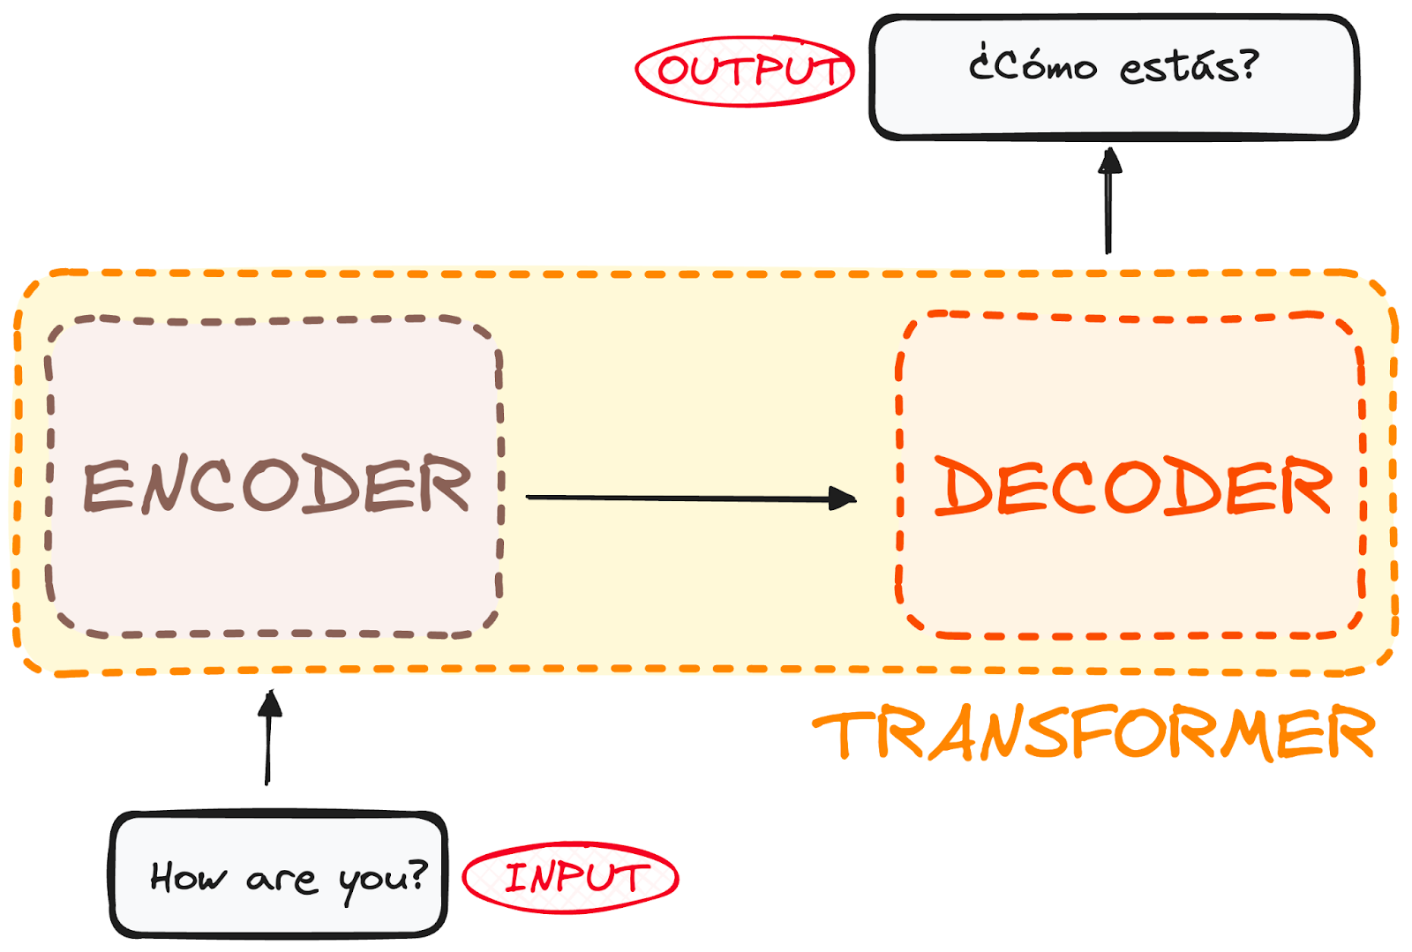
Transformer Model

Slide 36
Transformer Model
Encoders Job
An encoder is a neural network layer (or a stack of layers) designed to process and transform input data into a useful internal representation.
In NLP, the encoder's job is to convert raw input data (like sentences or documents) into a high-dimensional vector space where the meaning, context, and relationships between words are captured effectively.

Slide 37
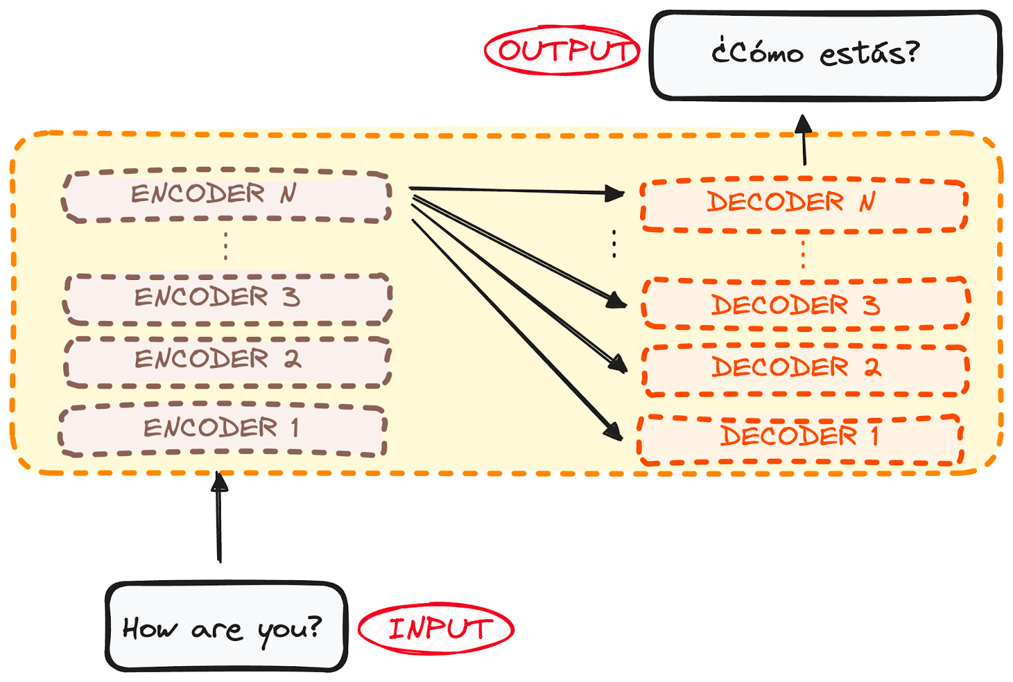
Transformer Model

Slide 38
Transformer Model
Encoders Job
Each encoder layer in a Transformer model takes the embeddings from the previous layer and refines them by focusing on different relationships and structures in the input.
Early layers focus on basic relationships (like word pairings or nearby connections), while deeper layers capture more complex meanings and dependencies.
The result is a set of embeddings that effectively capture the context and meaning of the entire input sequence.

Slide 39
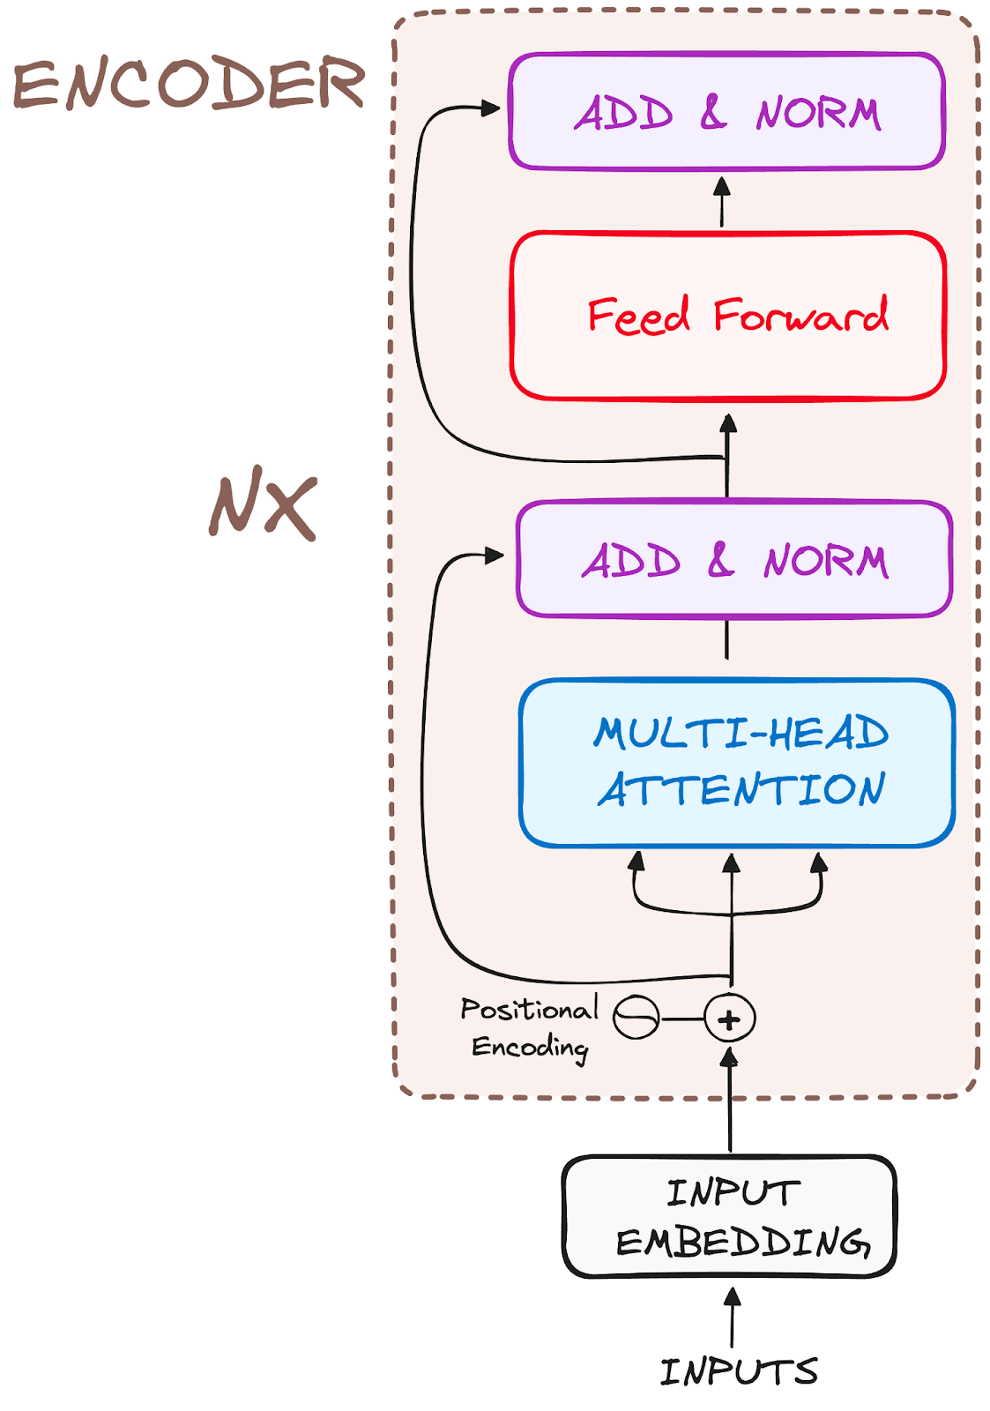
The Encoder WorkFlow

Slide 40
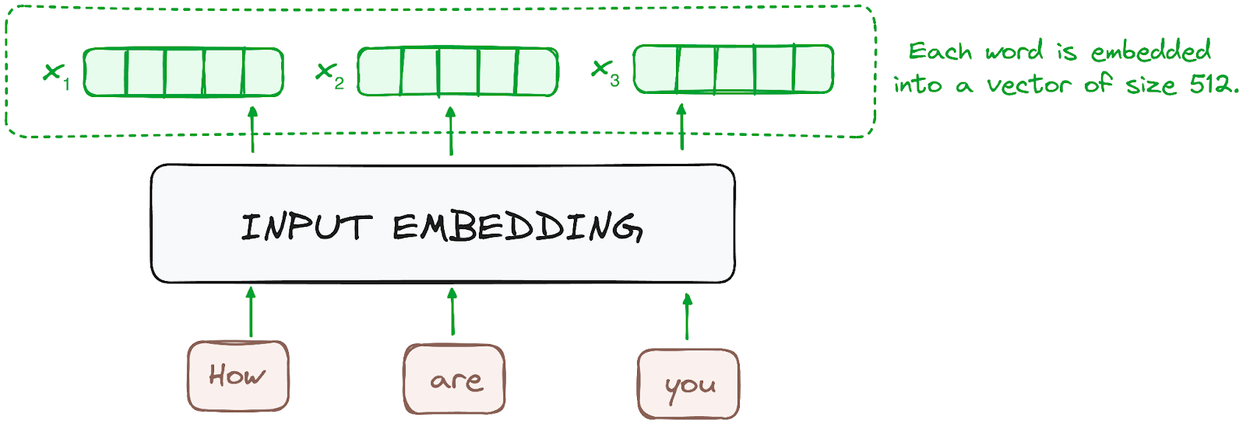
The Encoder WorkFlow
STEP 1 - Input Embeddings

Slide 41
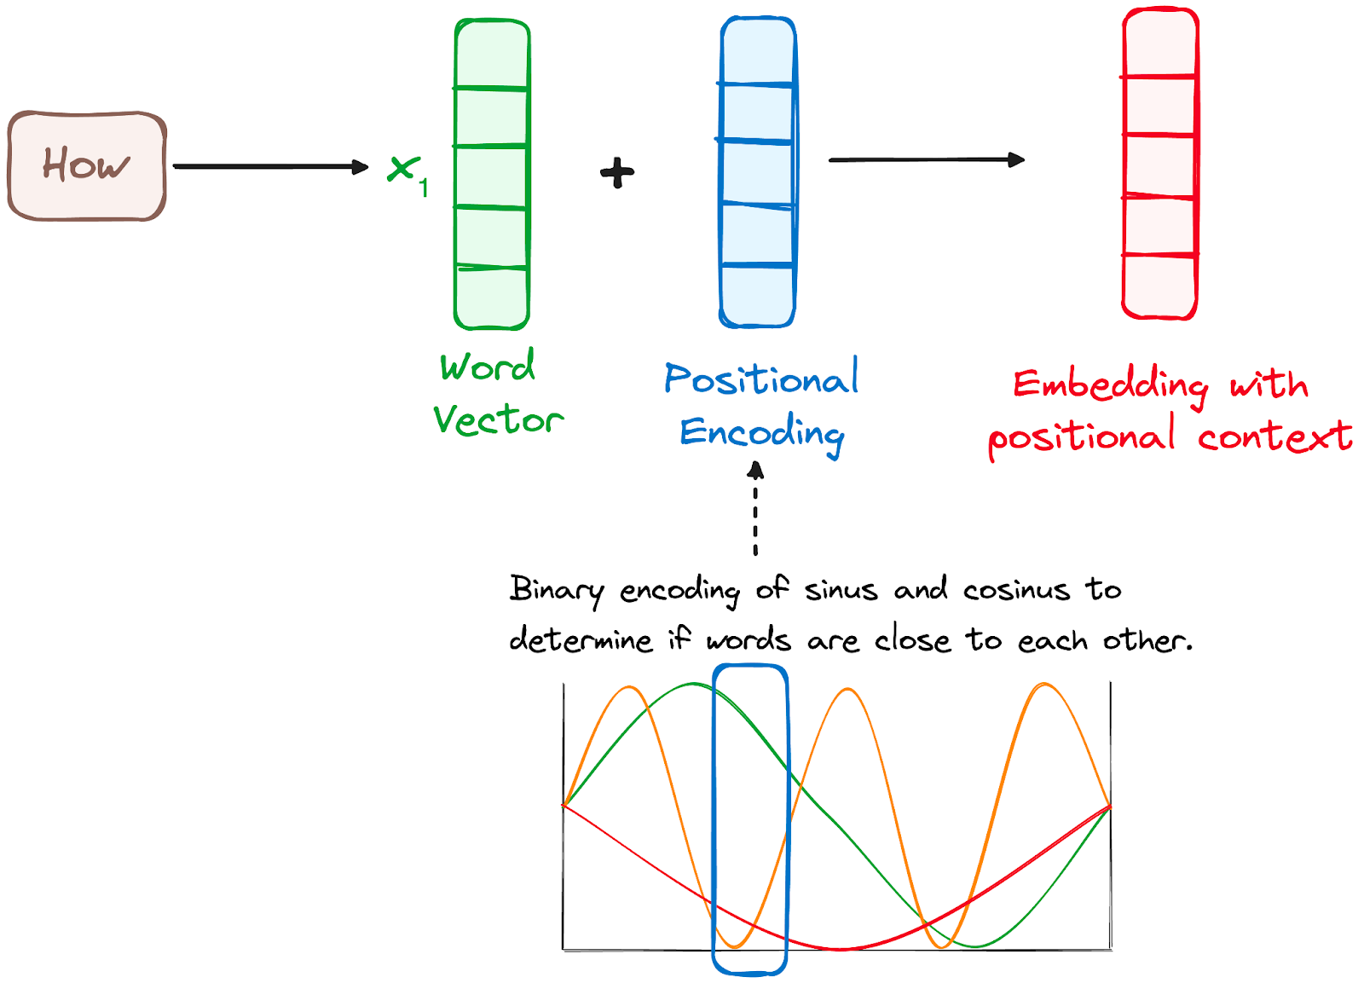
The Encoder WorkFlow
STEP 2 - Positional Encoding
Since Transformers do not have a recurrence mechanism like RNNs, they use positional encodings added to the input embeddings to provide information about the position of each token in the sequence.

Slide 42
The Encoder WorkFlow
STEP 3 Multi-Headed Self-Attention Mechanism
For each token, three vectors are computed: Query (Q), Key (K), and Value (V). These vectors are obtained by multiplying the input embedding by three learned weight matrices: W_{Q}, W_{K}, W_{V}

Slide 43
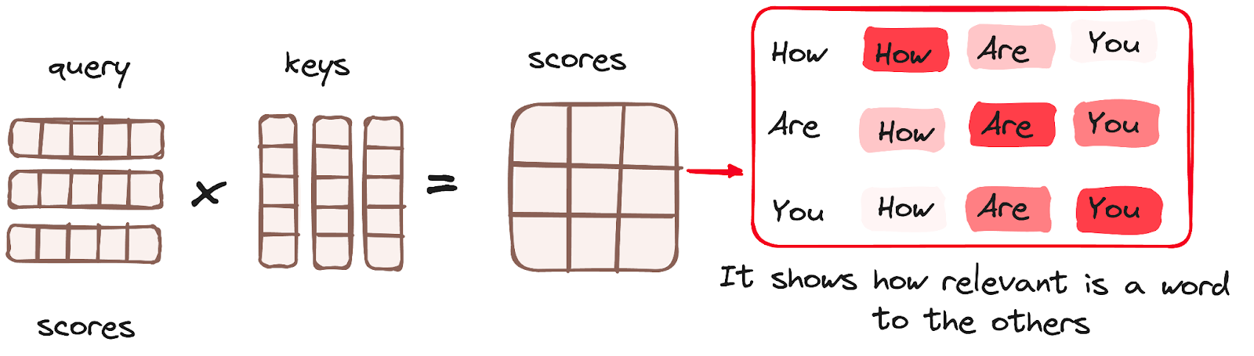
The Encoder WorkFlow
STEP 3 Multi-Headed Self-Attention Mechanism
The attention scores are calculated by taking the dot product of the query vector of one token with the key vectors of all tokens, resulting in a score matrix that represents how much focus each word should have on the other words in the sequence.

Slide 44
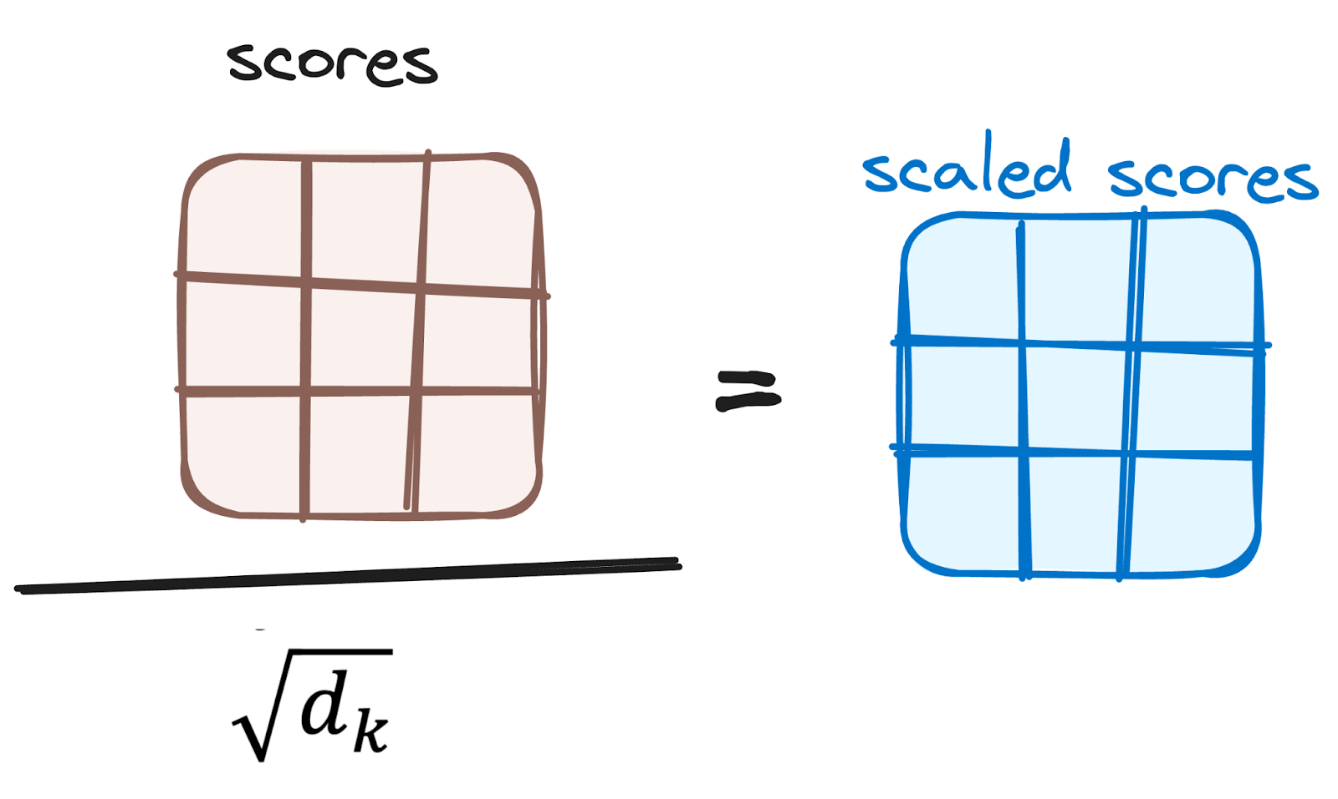
The Encoder WorkFlow
STEP 3 Multi-Headed Self-Attention Mechanism
Reducing the Magnitude of attention scores: The scores are then scaled down by dividing them by the square root of the dimension of the query and key vectors.

Slide 45
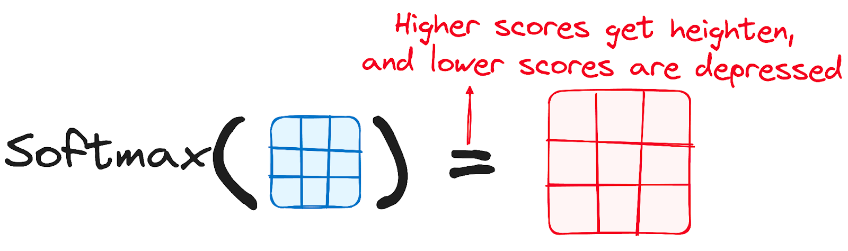
The Encoder WorkFlow
STEP 3 Multi-Headed Self-Attention Mechanism
Applying Softmax to the Adjusted Scores: This results in probability values ranging from 0 to 1. The softmax function emphasizes higher scores while diminishing lower scores, thereby enhancing the model's ability to effectively determine which words should receive more attention.

Slide 46
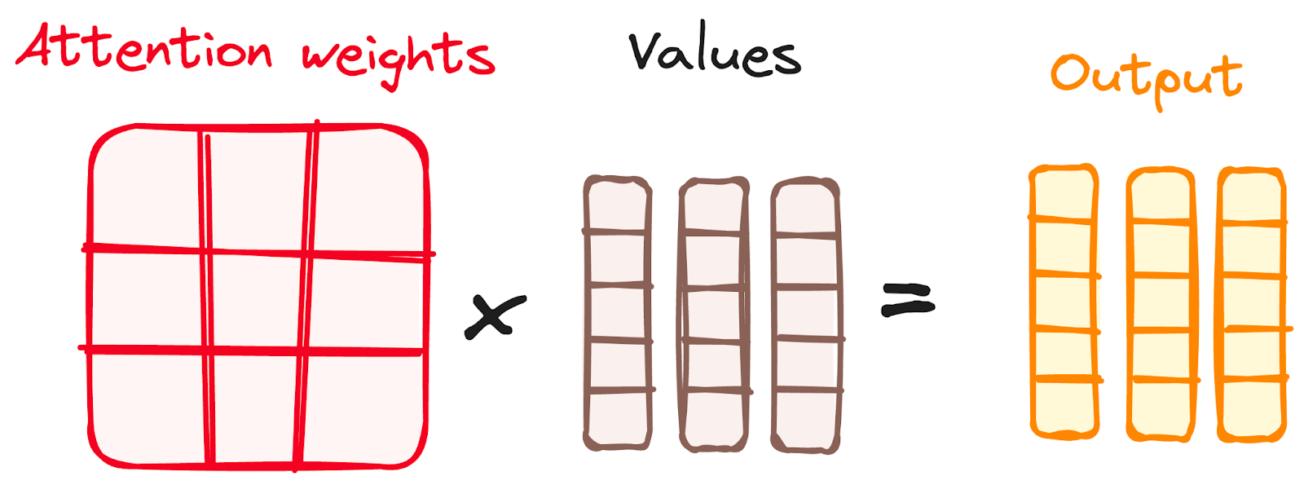
The Encoder WorkFlow
STEP 3 Multi-Headed Self-Attention Mechanism
Combining Softmax Results with the Value Vector: weights derived from the softmax function are multiplied by the value vector, resulting in an output vector.

Slide 47
The Encoder WorkFlow
STEP 3 Multi-Headed Self-Attention Mechanism
Why Called Multi Head: Instead of using a single set of Q, K, V vectors, the multi-head attention mechanism uses multiple sets (or "heads") with different learned weight matrices.
This allows the model to capture different types of relationships and patterns from different "heads" or "perspectives." The outputs from all heads are concatenated and linearly transformed to produce the final self-attention output.

Slide 48
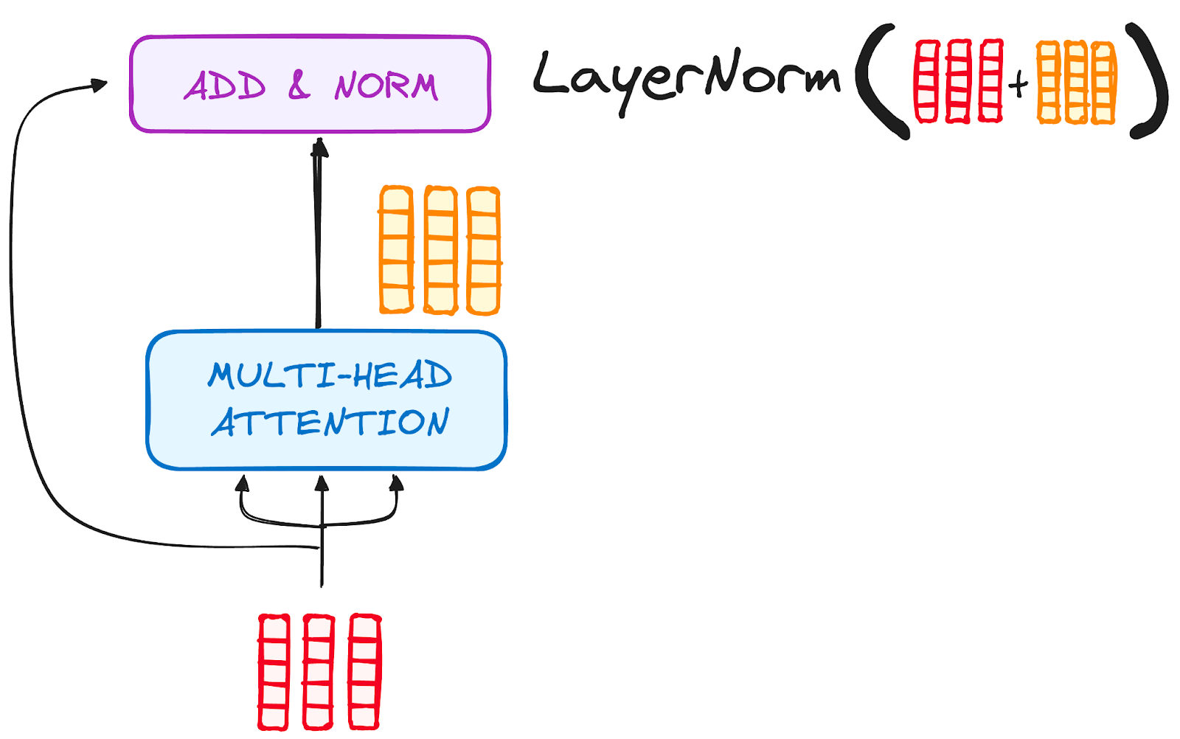
The Encoder WorkFlow
STEP 4 Normalization and Residual Connections
Residual Connection: A shortcut connection that bypasses the multi-head attention sub-layer and added in “Add & Norm Layer” directly.
Residual
Connection

Slide 49
The Encoder WorkFlow
STEP 4 Normalization and Residual Connections
Residual Connection: A shortcut connection that bypasses the multi-head attention sub-layer and added in “Add & Norm Layer” directly.
Residual
Connection

Slide 50
The Encoder WorkFlow
STEP 4 Normalization and Residual Connections
Normalization: is about adjusting the data to have specific statistical properties (like mean = 0, variance = 1).
Example:
If you have data points [10,20,30], normalization could transform them to something like [−1,0,1], adjusting them to have a mean of 0 and variance of 1.

Slide 51
The Encoder WorkFlow
STEP 5 Feed-Forward Neural Network
The Feed-Forward Network (FFN) layer is a fully connected neural network that processes each token independently.
The feed-forward network in the Transformer consists of two main layers:
Linear (Dense) Layer 1: Applies a linear transformation to increase the dimensionality.
Rectified Linear Unit Function (ReLU): Introduces non-linearity to the model, enabling it to learn complex patterns.
Linear (Dense) Layer 2: Applies another linear transformation to project back to the original dimensionality.

Slide 52


The Encoder WorkFlow
STEP 5 Feed-Forward Neural Network
Example:
Let input to feed forward layer is x=[2,−1,3]
First Linear Transformation (to higher-dimensional space):
x1​=xW₁​+b₁​
4-Dimension

Slide 53

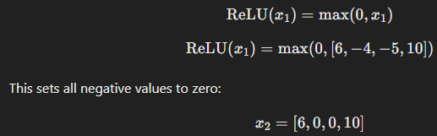
The Encoder WorkFlow
STEP 5 Feed-Forward Neural Network
ReLU Activation Function:

Slide 54

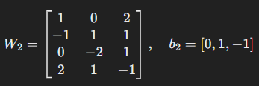


The Encoder WorkFlow
STEP 5 Feed-Forward Neural Network
Second Linear Transformation (to lower-dimensional space):
4-Dimension
3-Dimension

Slide 55
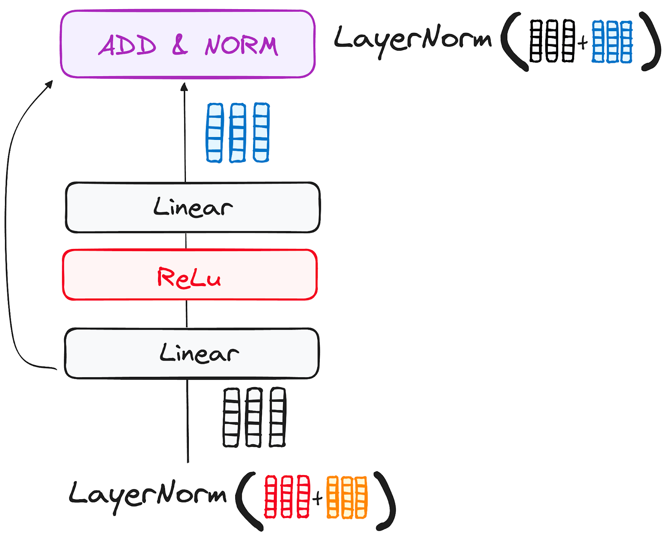
The Encoder WorkFlow
STEP 5 Feed-Forward Neural Network

Slide 56
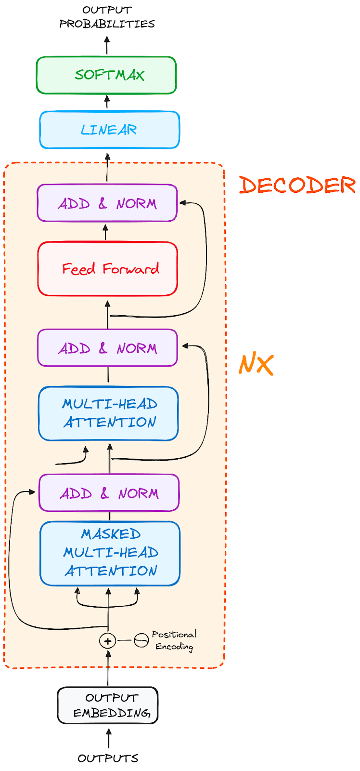
The Decoder WorkFlow

Slide 57
The Decoder WorkFlow
Initialization: The process starts with an initial input token, usually a special token like <BOS> (beginning of sequence) or <SOS> (start of sentence). This token indicates the start of the text generation.
First Step: Generate the First Token
Subsequent Steps: Generate Next Tokens
Repeat Until Stopping Condition: The decoding continues until a stopping condition is met — typically when a special <EOS> (end of sequence) token is generated, or a maximum length limit is reached.

Slide 58
The Decoder Key Components
Masked Multi-Head Attention
Multi-Head Attention
Feed Forward Layer
Add & Norm Layer

Slide 59
The Decoder Key Components
Masked Multi-Head Attention
Masked Multi-Head Attention is a variation of multi-head attention that is used to ensure that, during training or generation, a model does not "see" future words it is trying to predict.
During Training: Masked multi-head attention is essential to prevent the model from seeing future tokens, ensuring it learns to predict sequentially
Inference: Masking is generally not required by default because the model generates tokens one by one in an autoregressive manner. However, it can still be useful for specific decoding strategies like beam search or managing partial sequences.

Slide 60
THANKS

